Slide 1


Feel free to leave speaker notes or inline comments on any slide—our design team will review them and help enhance your deck wherever needed.
Feel free to leave speaker notes or inline comments on any slide—our design team will review them and help enhance your deck wherever needed.
Feel free to leave speaker notes or inline comments on any slide—our design team will review them and help enhance your deck wherever needed.
GUIDELINES
How to Use This Deck for Your Session
Welcome to the Packt ML Summit 2025! This template is designed to help you deliver a high-impact, well-paced session. Feel free to duplicate, remove, or reorder slides based on your talk format.
REQUIRED SLIDES
STARTING NOW: This will go on the waiting screen for ~30-60 seconds before you go LIVE.
Session TITLE
About The Speaker
Agenda
Content Slides
Thank You
OPTIONAL SLIDES
Code snippets / architecture diagrams
Case Studies or example walkthroughs
Session TITLE
Audience Poll: We can automate the poll via the platform and obtain real time results as users take the poll. Good prop to engage.
Resources
FORMAT SPECIFIC
Power Talk (30 min): Focus on content + clear takeaways
Tech Talk (45 min): Deep dive with walkthroughs and demo
Workshop: Include setup instructions, step-by-step structure
Feel Free to leave speaker notes or comments on any slide – our design team will review and help enhance your deck wherever needed.

Slide 2

Starting Now
Data-Centric AI & Label Quality Engineering
How bias, operating domain, and data entry drive AI performance
Thomas Nield
Book Author & Instructor

Slide 3
About Thomas Nield
Author of books:
Essential Math for Data Science (O’Reilly)
Learning RxJava (Packt)
Getting Started with SQL (O’Reilly)
Worked nearly a decade in the airline industry developing operations research algorithms.
Instructor at University of Southern California teaching Artificial Intelligence System Safety in the Aviation Safety and Security Program
Instructor in data science, artificial intelligence, machine learning, and analytics.
Inventor and startup founder
Thomas Nield
Book Author & Instructor

Slide 4
Agenda
01
Data Quality Techniques
02
Data Coverage
03
Identifying Bias

Slide 5

Section 1: Data Quality Techniques

Slide 6
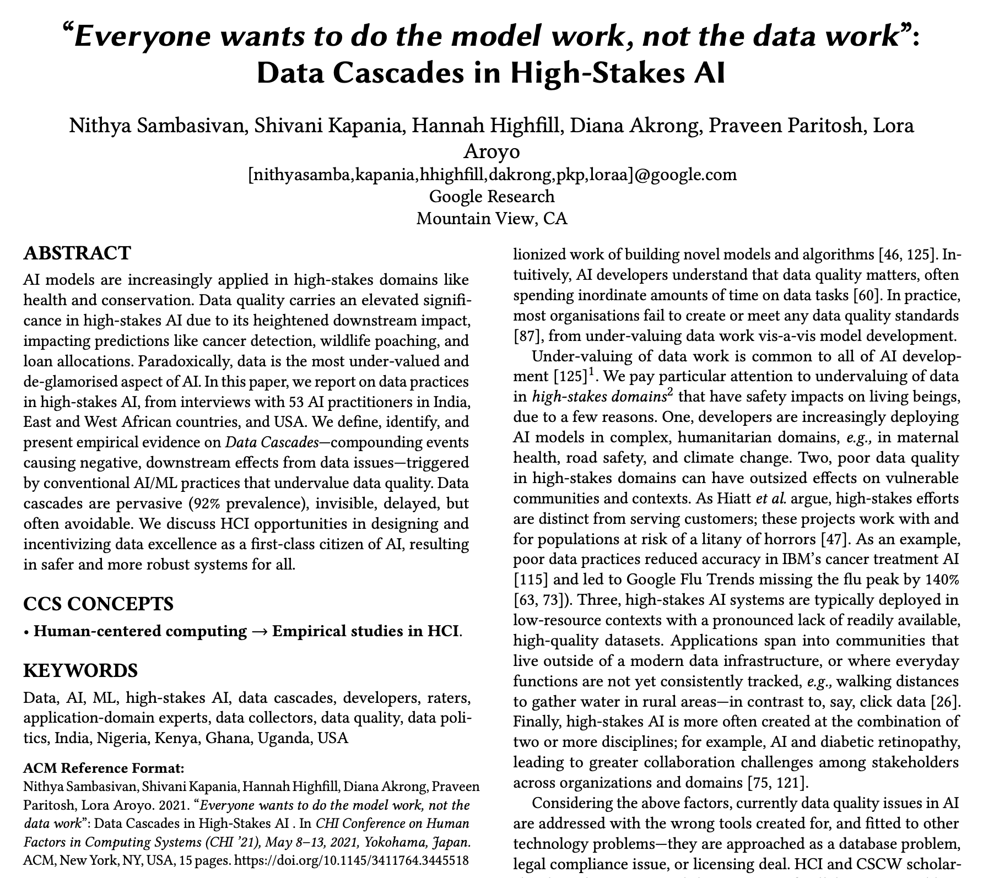
Intro
Why This Matters
ML model performance is often bottlenecked by data quality, not architecture.
In 2021, Google released a paper titled Everyone wants to do the model work, not the data work.
The researchers argued that despite data being the most critical part of getting AI models to perform optimally, it is the unexciting part nobody wants to do.
Let’s talk about how we can contemplate data quality by putting an emphasis on the contexts surrounding it.
https://research.google/pubs/everyone-wants-to-do-the-model-work-not-the-data-work-data-cascades-in-high-stakes-ai/
>

Slide 7

Intro
Data Cascades in High-Stakes AI
ABSTRACT
“AI models are increasingly applied in high-stakes domains like health and conservation. Data quality carries an elevated significance in high-stakes AI due to its heightened downstream impact, impacting predictions like cancer detection, wildlife poaching, and loan allocations. Paradoxically, data is the most under-valued and de-glamorized aspect of AI. In this paper, we report on data practices in high-stakes AI, from interviews with 53 AI practitioners in India, East and West African countries, and USA. We define, identify, and present empirical evidence on Data Cascades—compounding events causing negative, downstream effects from data issues—triggered by conventional AI/ML practices that undervalue data quality. Data cascades are pervasive (92% prevalence), invisible, delayed, but often avoidable. We discuss HCI opportunities in designing and incentivizing data excellence as a first-class citizen of AI, resulting in safer and more robust systems for all.”
https://research.google/pubs/everyone-wants-to-do-the-model-work-not-the-data-work-data-cascades-in-high-stakes-ai/
>

Slide 8
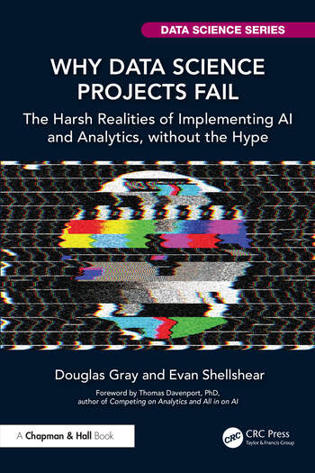
How to Improve AI Data Quality
Move from goodness-of-fit to goodness-of-data: use context to measure quality rather than chasing a “better performing” model.
Incentivize data excellence and bring attention to traceability and documentation of data all the way to its creation.
Have “real-world” proficiency with data, asking not just what the data says but where it comes from.
Manage the AI data lifecycle and bring visibility to it.
https://research.google/pubs/everyone-wants-to-do-the-model-work-not-the-data-work-data-cascades-in-high-stakes-ai/
>

Slide 9
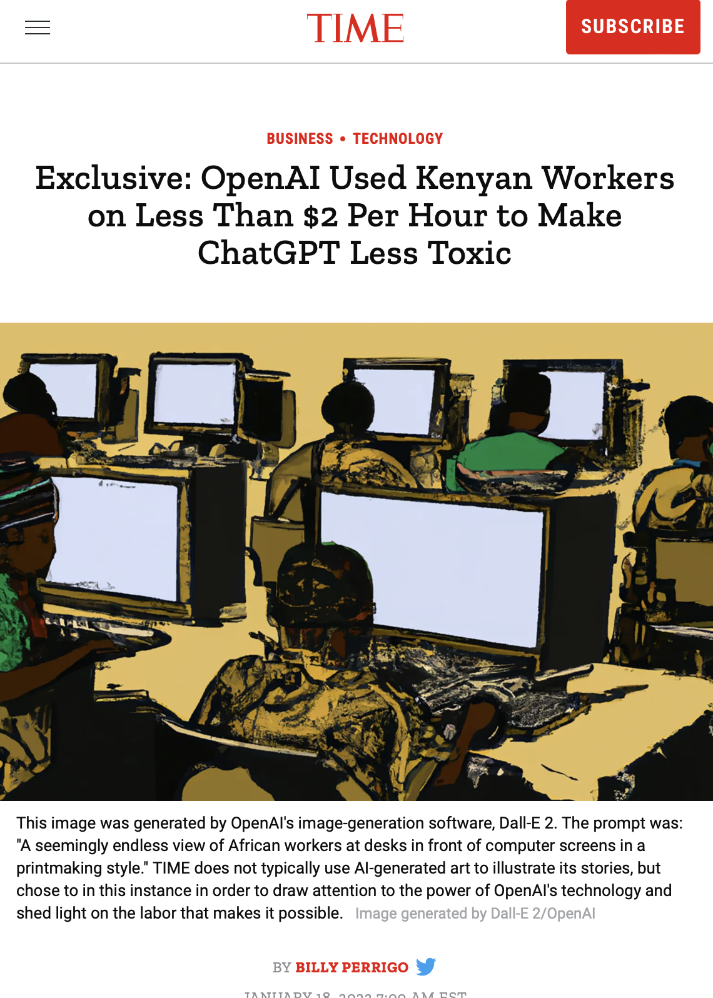
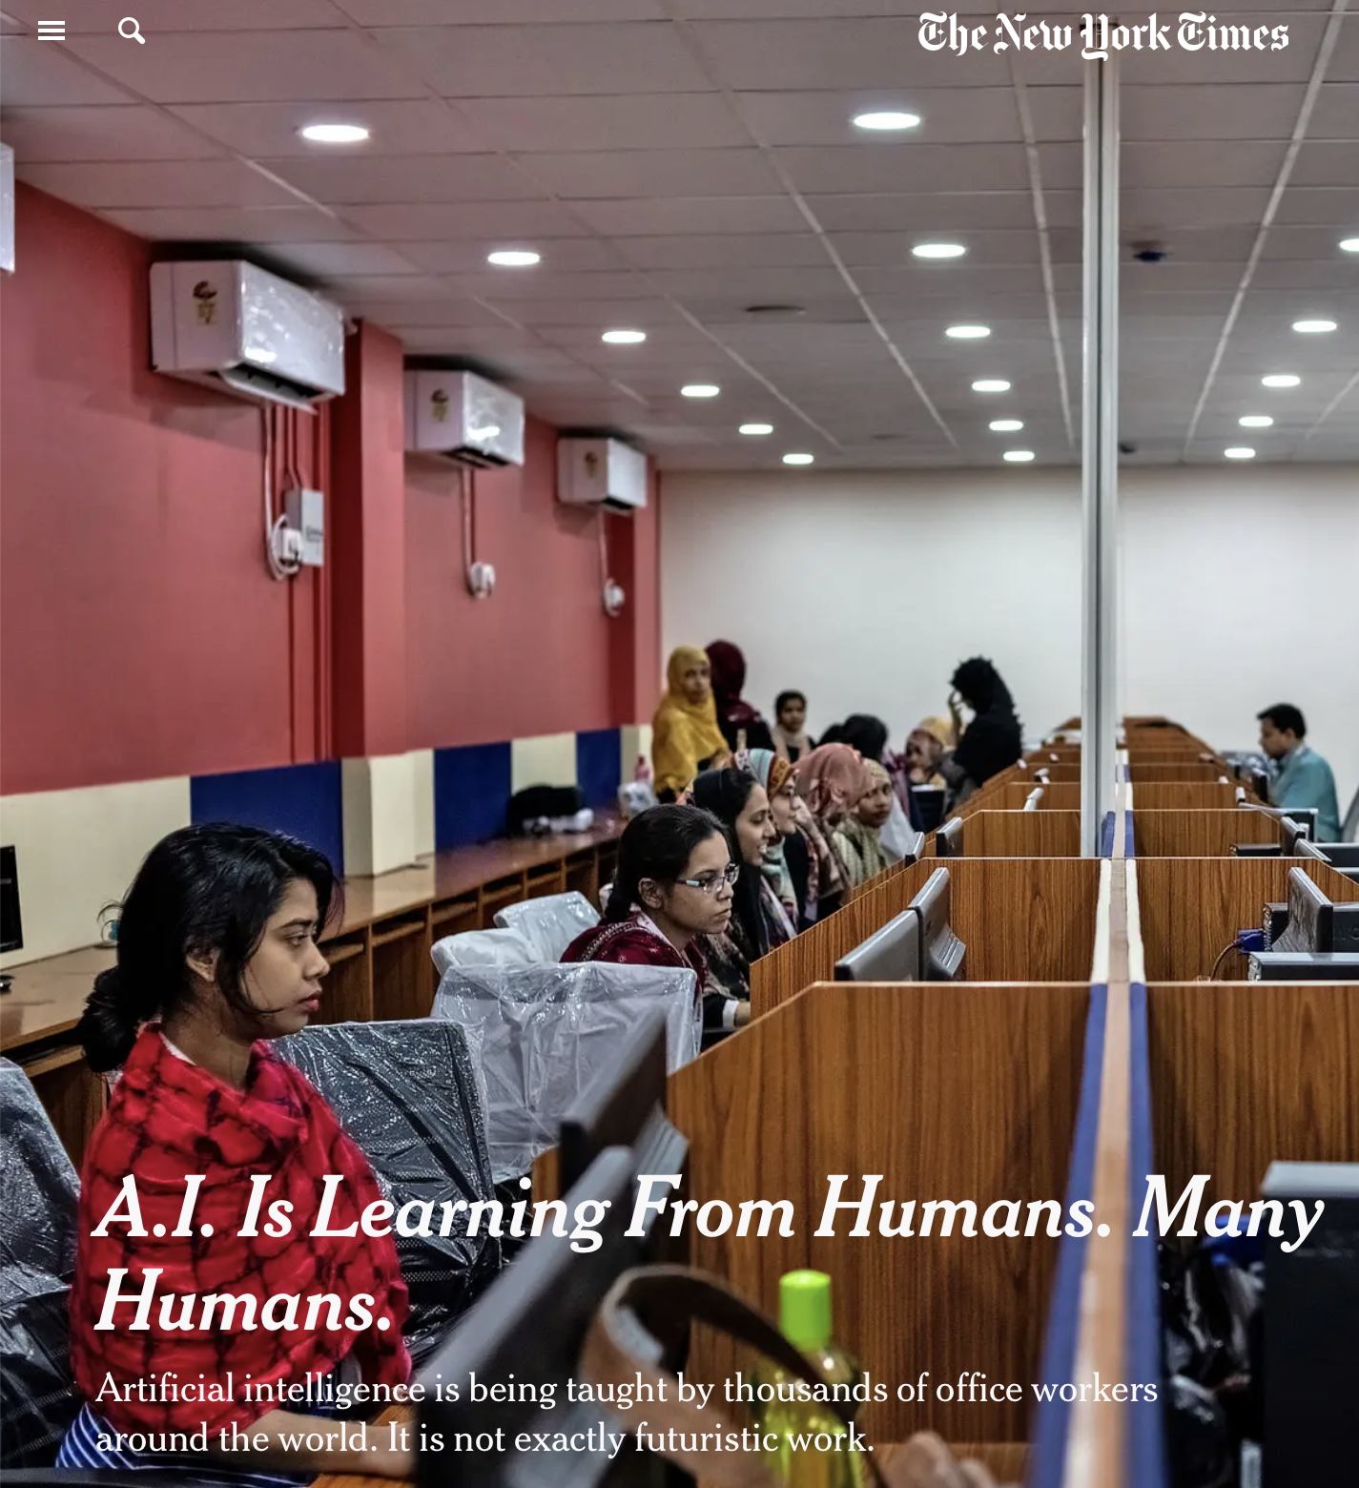

AI is Learning From Humans
https://time.com/6247678/openai-chatgpt-kenya-workers/
https://www.nytimes.com/2019/08/16/technology/ai-humans.html
https://www.washingtonpost.com/world/2023/08/28/scale-ai-remotasks-philippines-artificial-intelligence/
>

Slide 10



AI is Learning From Humans
>

Slide 11
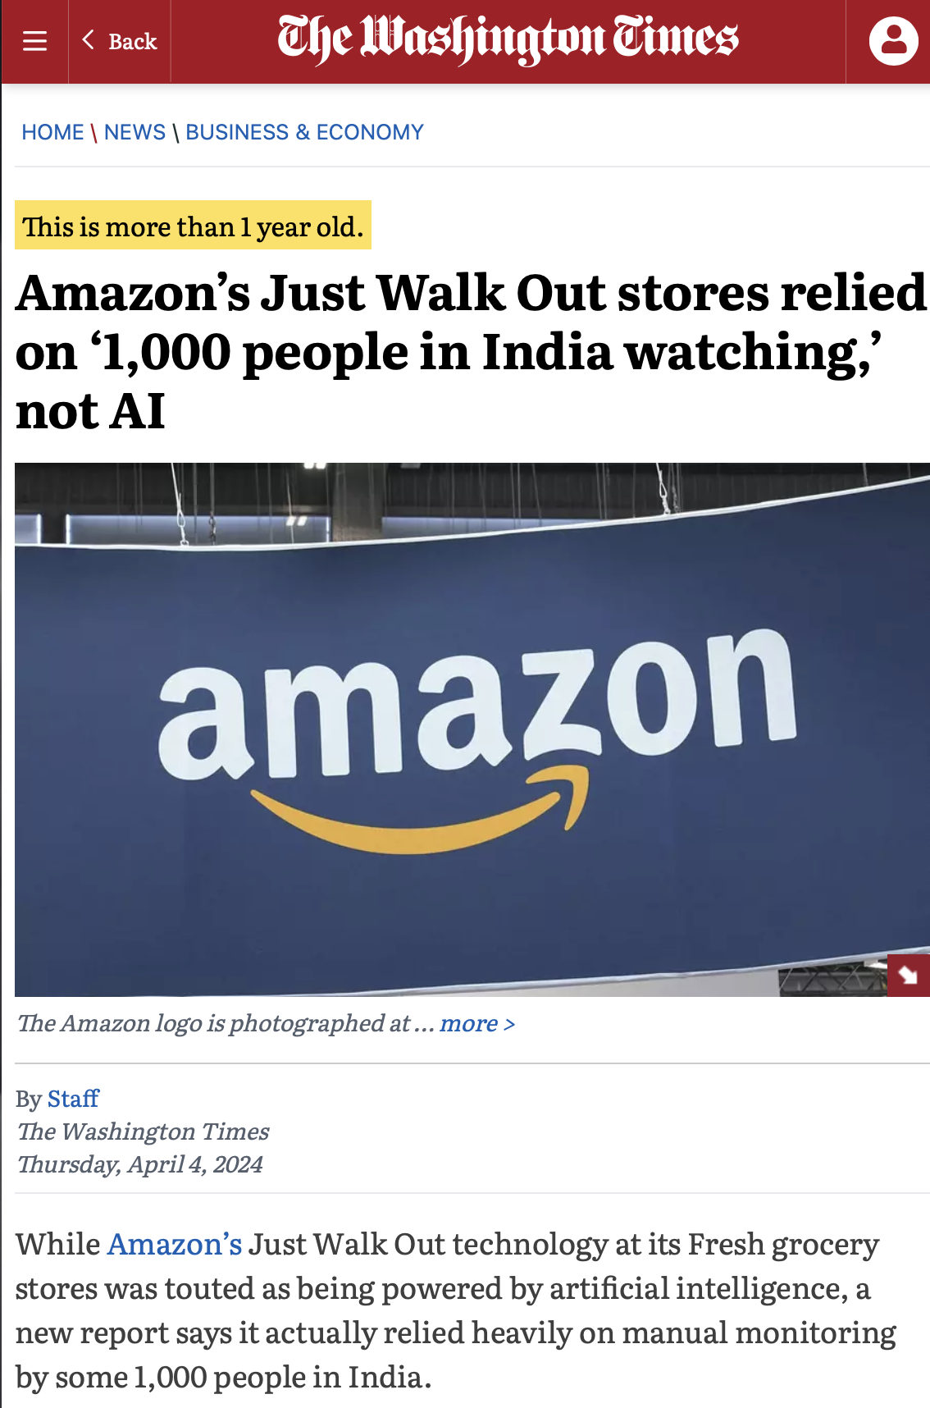
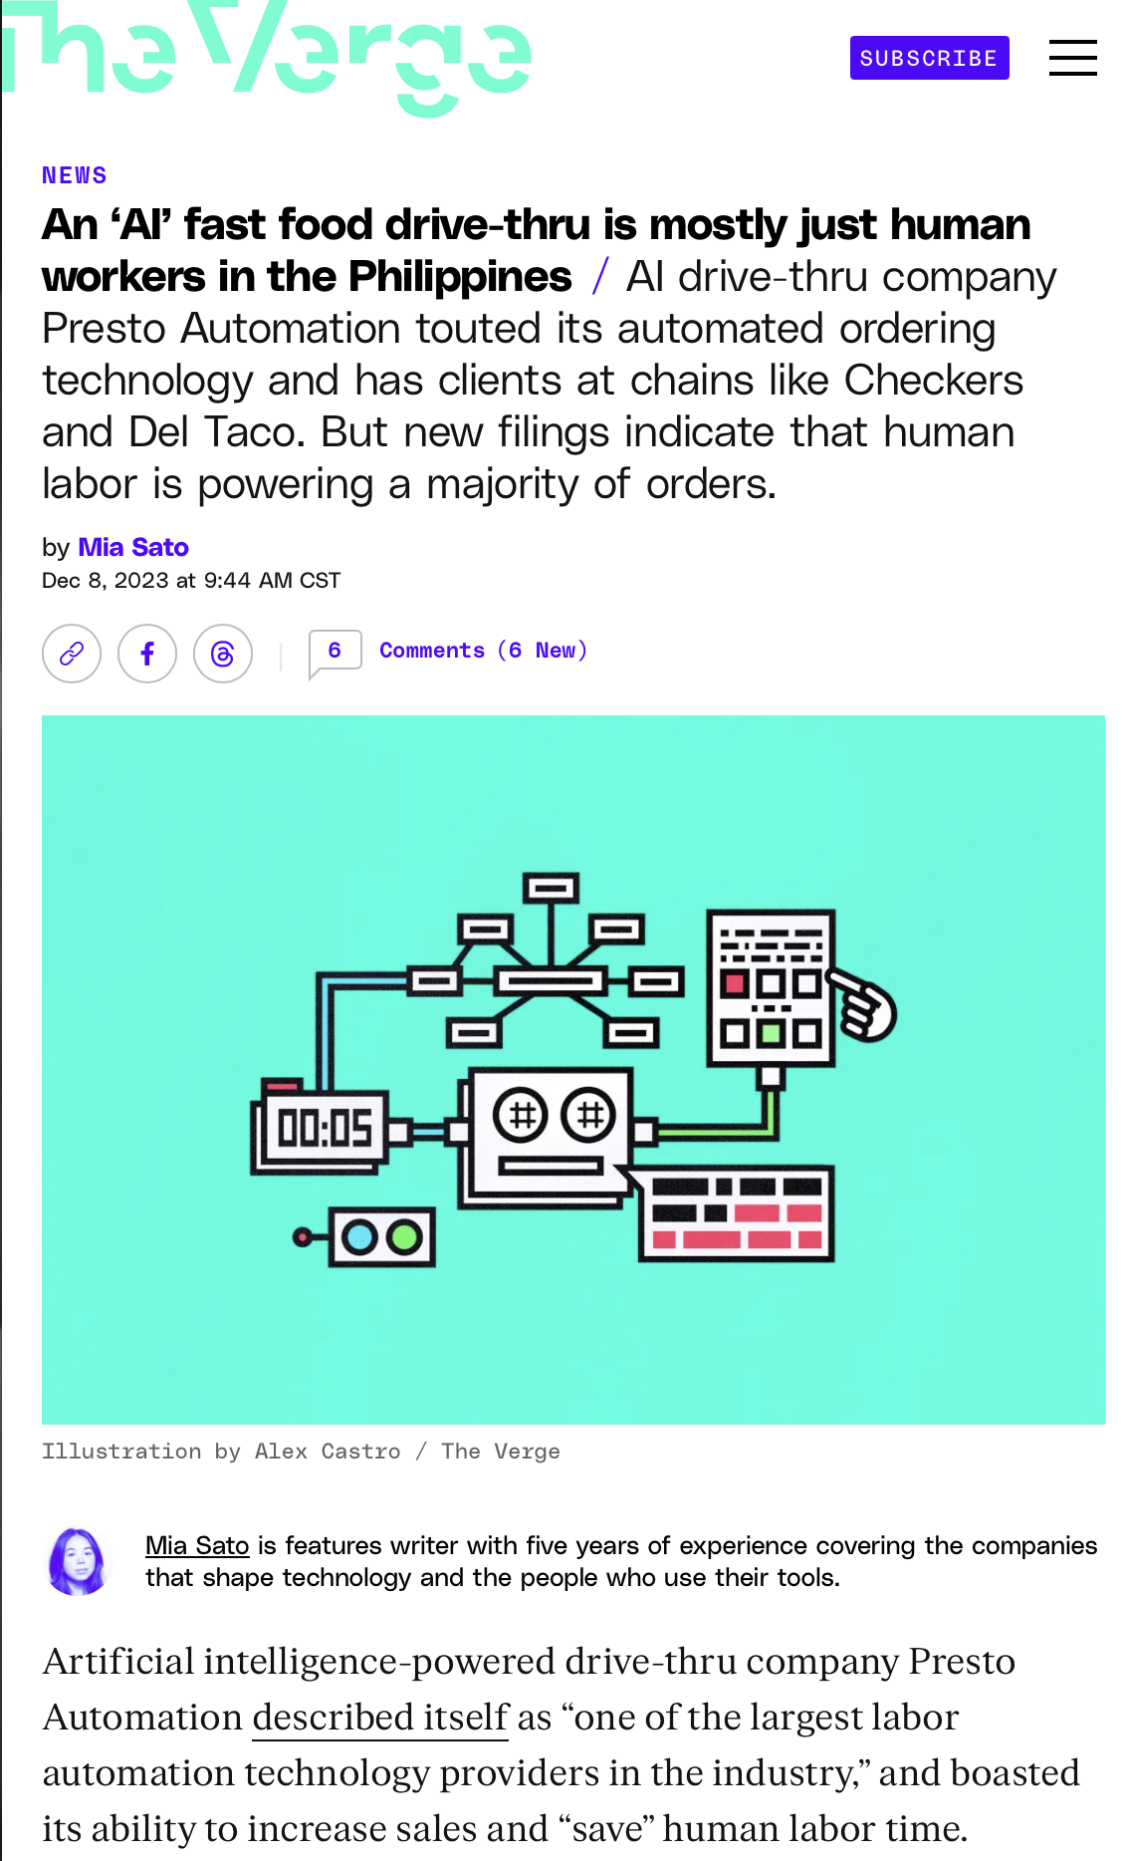
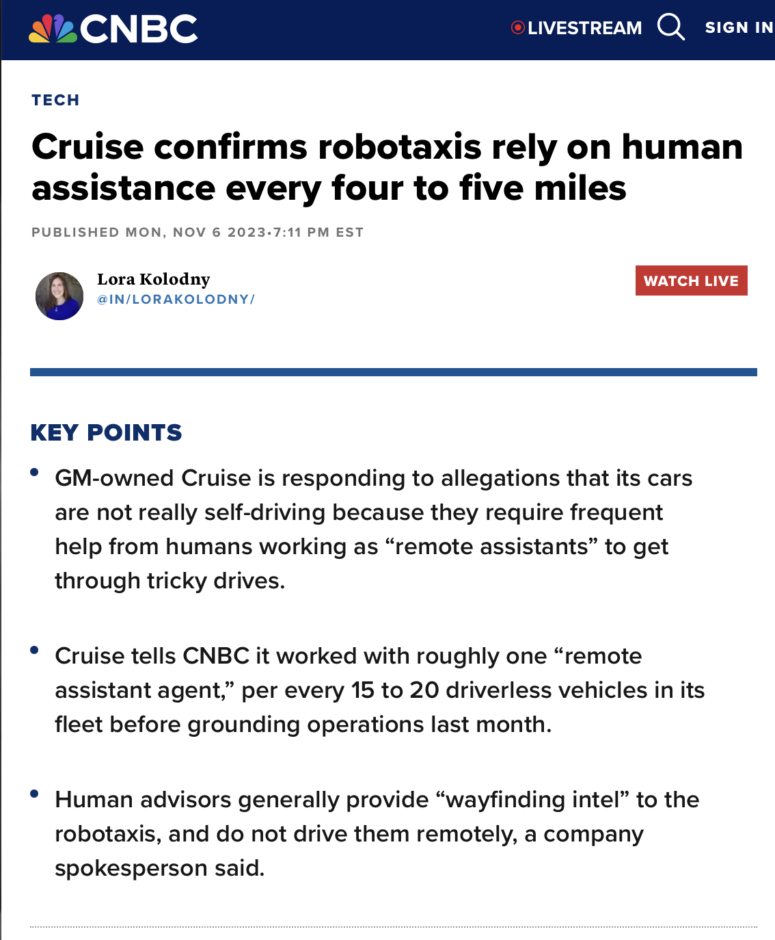
Sometimes the Humans Are Never Removed
>

Slide 12

Correction Techniques
There are three correction techniques we will talk about:
Active learning
Weak supervision
Noisy label correction
These problems are not silver bullets, and they can have their own problems and biases, but they can be helpful in prioritizing what data to correct and speed up entry.
>

Slide 13
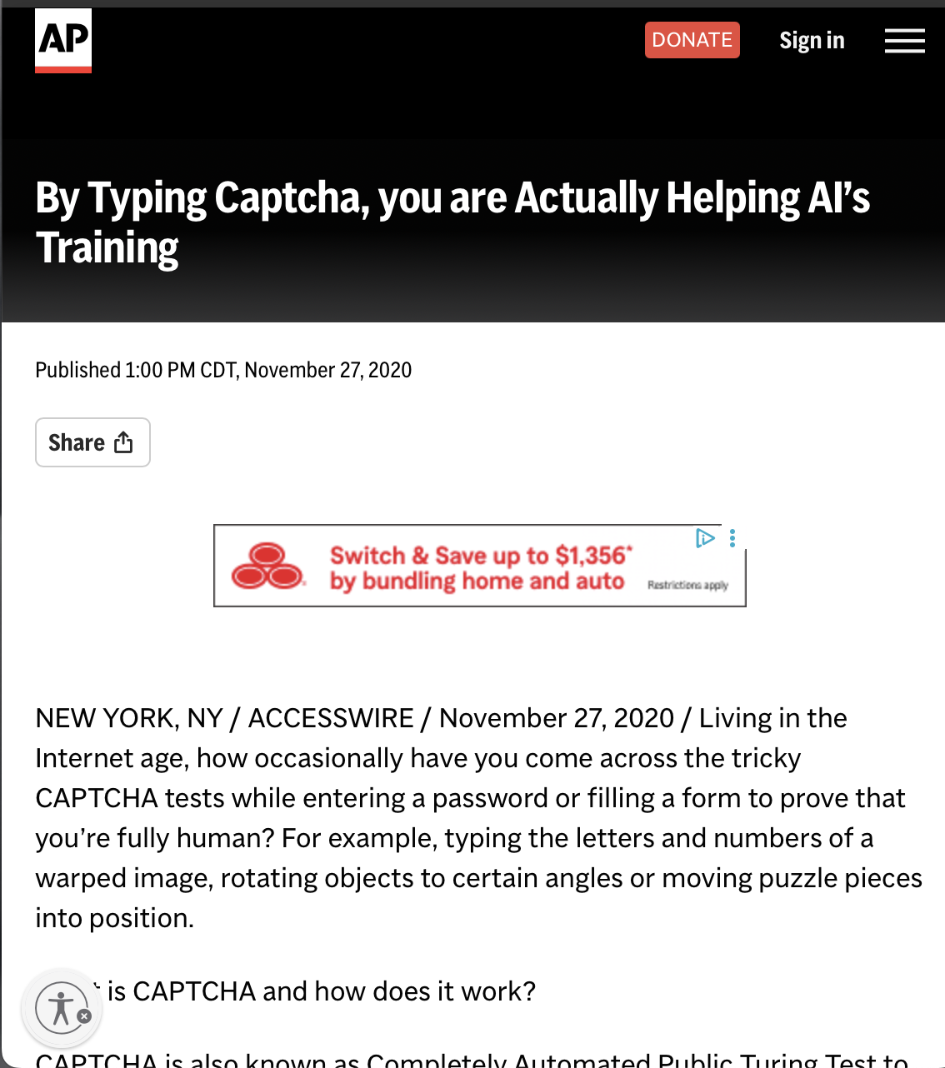
Active Learning
A semi-automated technique to improve data quality is through active learning.
Start with a small labelled data collection
Train the model
With larger amounts of data, have the model report entries it is uncertain about.
Have a human provide the correct labels.
Repeat.
EXAMPLES: Google ReCAPTCHA, medical image analysis, computer vision-based vehicular automation
>
https://apnews.com/article/technology-technology-issues-digitization-spamming-artificial-intelligence-9e2aec49792c3a1e31c1f94f1a5e7ede

Slide 14
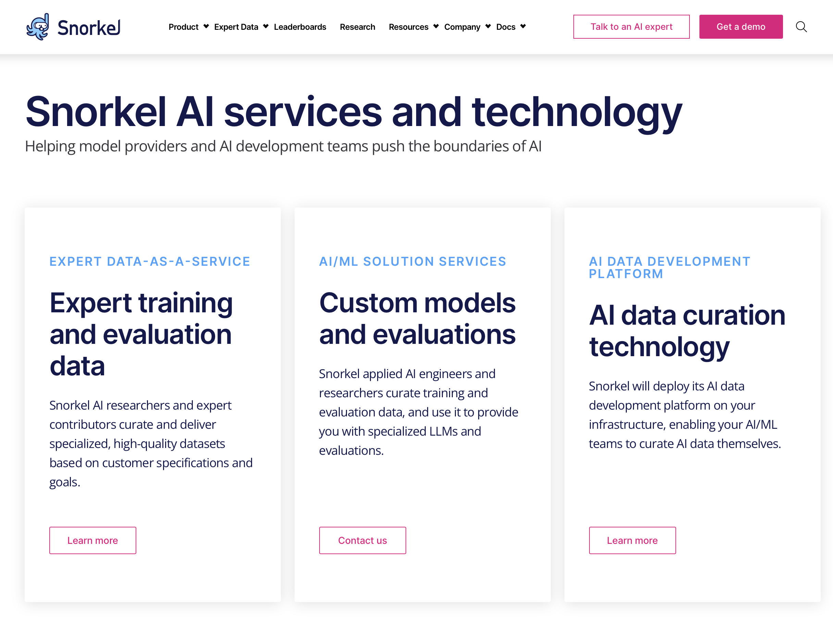
Weak Supervision
A semi-automated technique to improve data quality with larger amounts of less accurate data.
Start with a noisy dataset
Use hardcoded rules to predict labels for chunks of it.
Aggregate and train with those labels using tools like Snorkel.
Repeat.
EXAMPLES: Social media content moderation, medical diagnoses, sentiment analysis
>

Slide 15
Noisy Label Correction
A technique to identify possibly mislabeled, noisy data, by using a trained model.
Have a trained model or algorithm to detect wrongful labels.
Make human review corrections to those labels.
Train the machine learning algorithm on that corrected data.
Repeat.
EXAMPLES: Crowdsourced data, misclassified spam emails
>

Slide 16
Section 2: Data Coverage

Slide 17

What is Data?
Imagine you were provided a photo of a family:
Do you know this family’s story based on just one photo?
What if you had 20 photos? 200 photos? 2000 photos? How many photos do you need to know their story?
Do you need photos of them in different situations? Home, work, school, and vacation? Alone and together? With relatives and friends?
How much can we know about this family just through photos? And how many/what photos do we need?
>

Slide 18
Data is Snapshots!
Data is just like photographs; it provides snapshots of a story at discrete points in time.
The continuous reality and contexts of the story are not captured, nor are the infinite number of variables in that story.
Today there is a great deal of emphasis on data collection, promoting the idea it can intelligently tell a story, even predict what happens next, and thus create artificial intelligence.
Is this realistic? Why or why not?
>

Slide 19
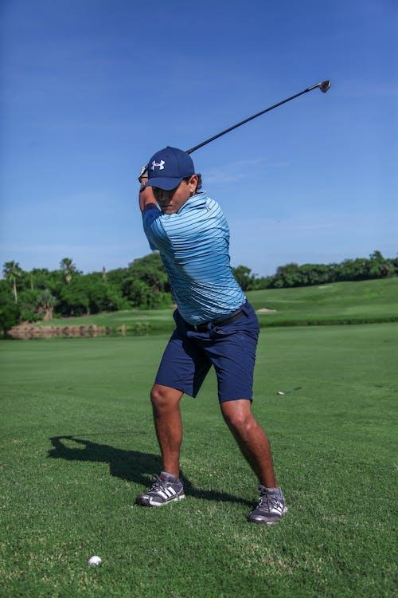
Data is Snapshots!
But how realistic is this objective? How narrow must our scope be to make it feasible?
A few strategic photos of the father playing golf can easily tell us whether he is good at golf.
A photo of him captured mid-swing.
A photo of him cheerful or lamenting at the 18th hole.
A photo of his scorecard!
But trying to decipher his entire life story through photos… that is a much harder problem.
>

Slide 20

Data is Snapshots!
Even with a narrow objective, it can still be hard to determine what is ground truth, or what is actually true given the data.
Let’s say we are trying to evaluate whether the father is good at golf based off those few chosen photos.
If we catch him fist-pumping at the hole, is he cheering for himself or someone else?
If we take a picture of the scorecard, how can we be sure it was not forged?
Data can be taken out of context or even forged, and it becomes more important to realize that data provides clues to the truth and is not actually the source of truth.
Ground Truth
>

Slide 21
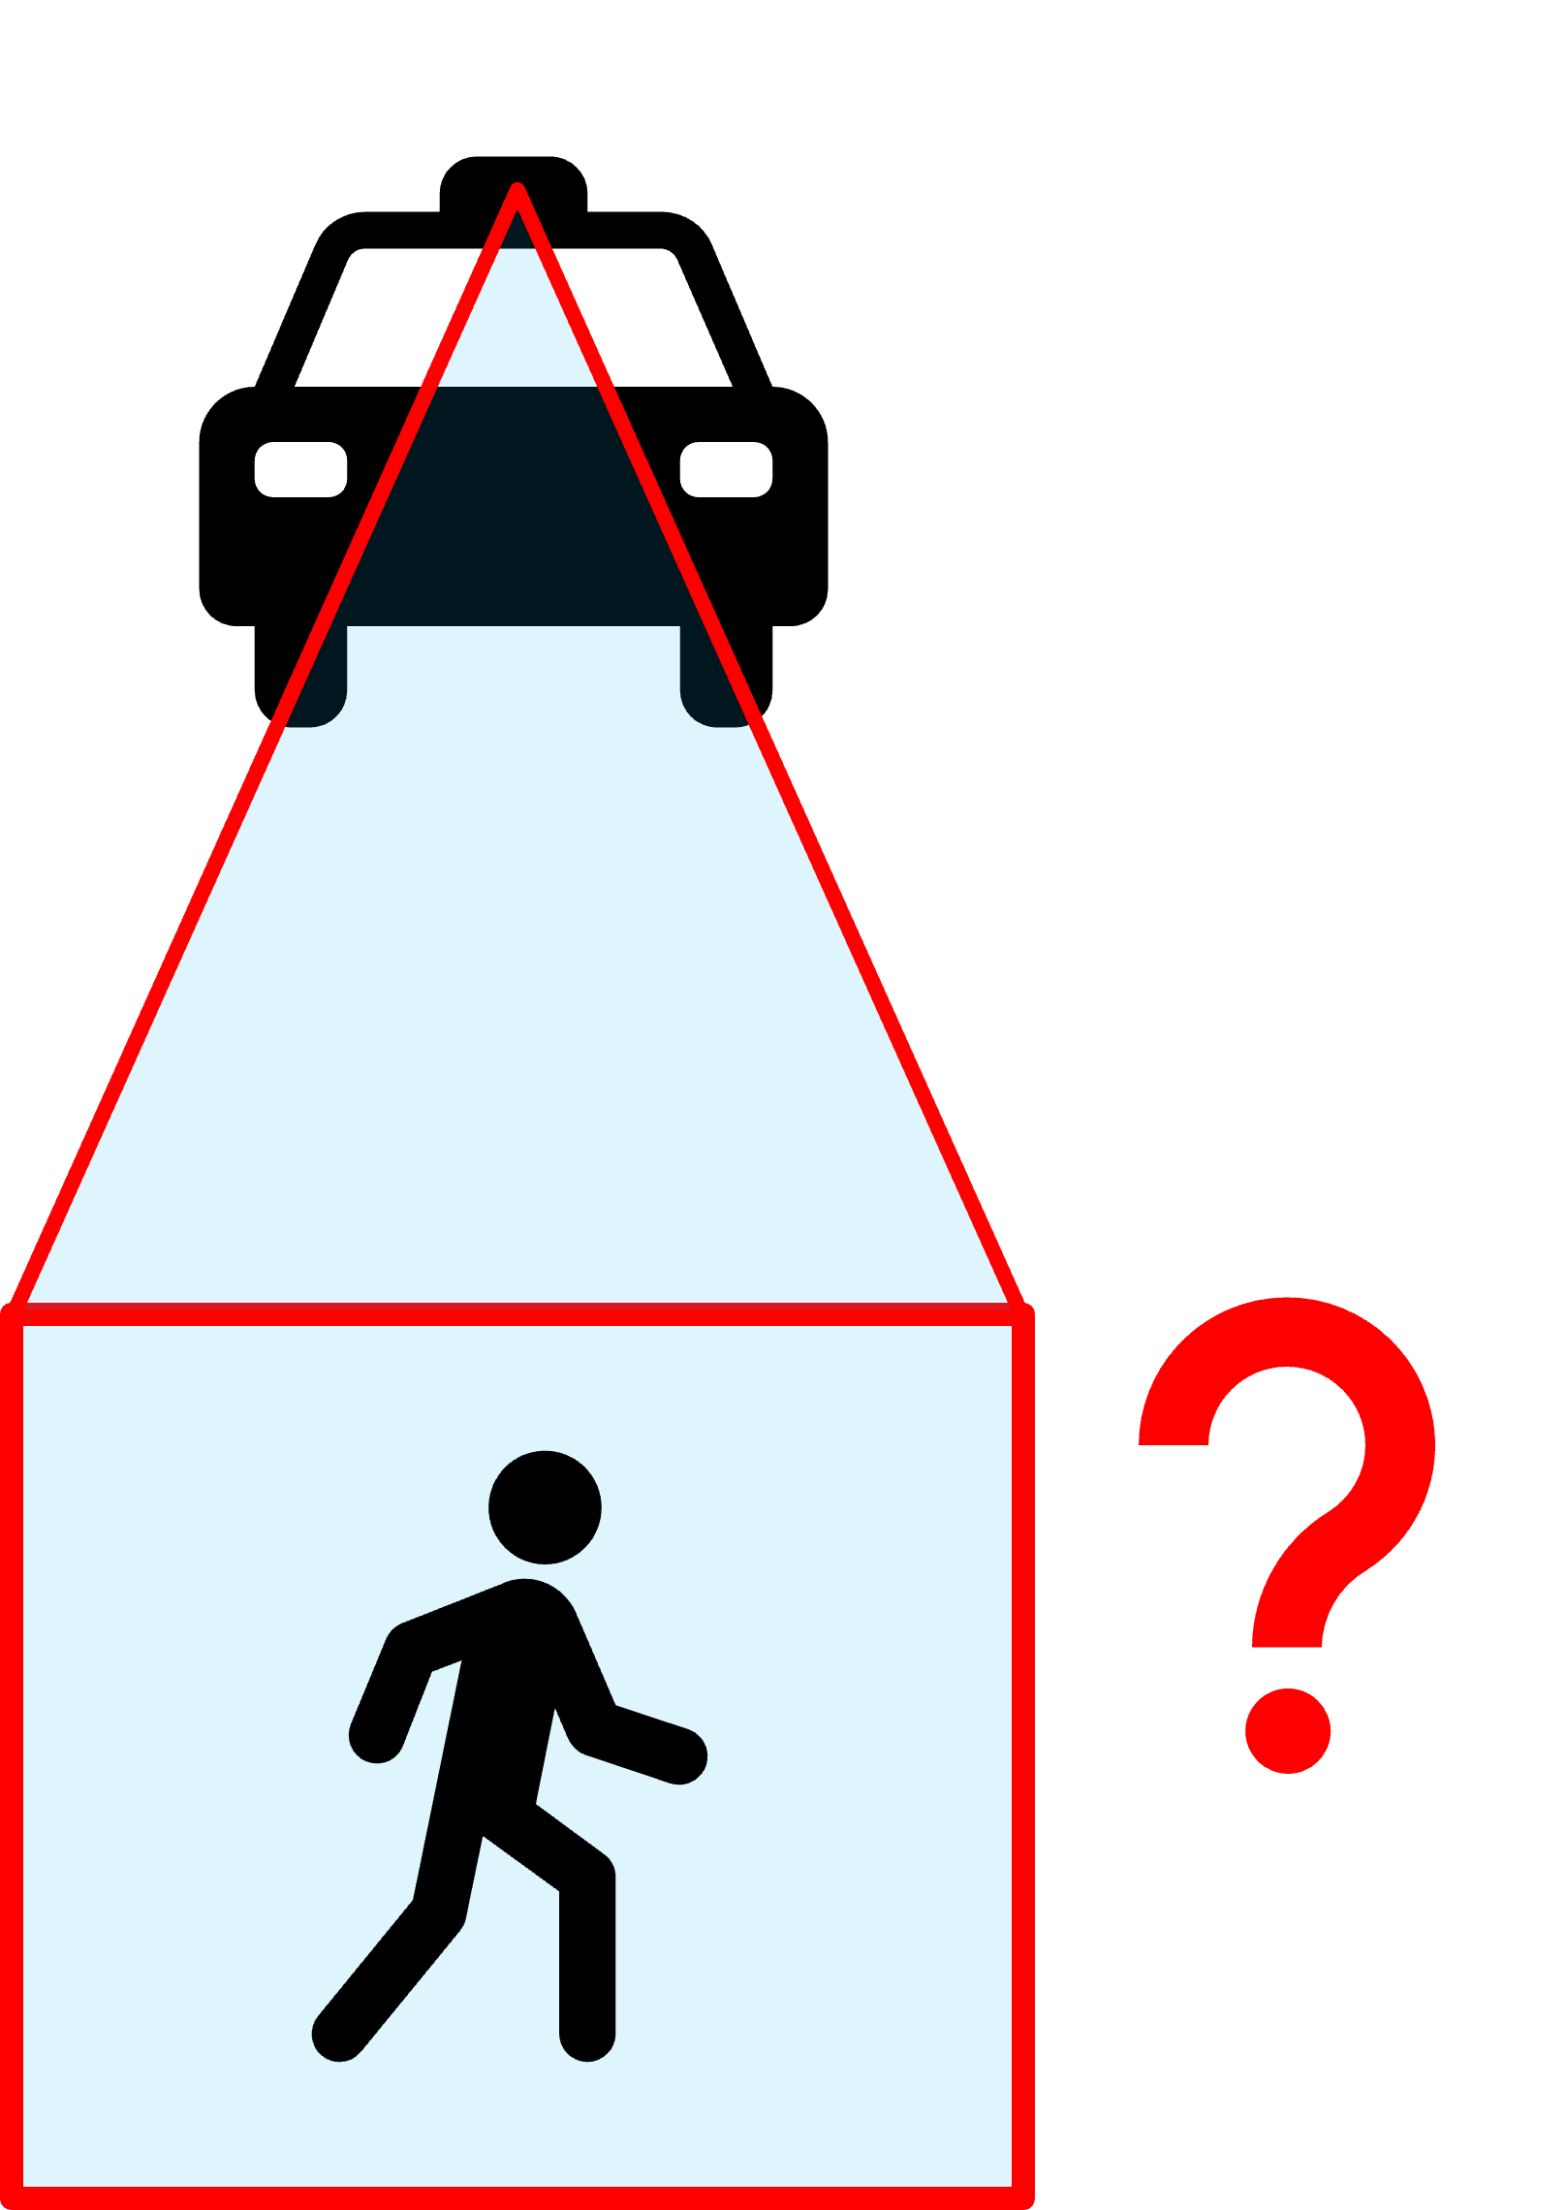
A Profound but Circuitous Question
In an AI system safety class, I had a student ask me this question:
“When a self-driving car has failed to recognize a pedestrian, how can it recognize that it failed to recognize the pedestrian [so it can self-correct]?”
What do you think?
Ground Truth
>

Slide 22
The Problem of Ground Truth
“When a self-driving car has failed to recognize a pedestrian, how can it recognize that it failed to recognize the pedestrian [so it can self-correct]?”
The paradox above is if the system could not recognize a pedestrian, how should it know that it failed to recognize a pedestrian?
If it was able to do the latter, then it should be able to achieve the former too.
Machine learning and their corrective algorithms are approximation, so there is always going to be a probability or margin of error.
Ground Truth
>

Slide 23
The Problem of Ground Truth
“When a self-driving car has failed to recognize a pedestrian, how can it recognize that it failed to recognize the pedestrian [so it can self-correct]?”
The paradox above is if the system could not recognize a pedestrian, how should it know that it failed to recognize a pedestrian?
If it was able to do the latter, then it should be able to achieve the former too.
Machine learning and their corrective algorithms are approximation, so there is always going to be a probability or margin of error.
Ground Truth
>

Slide 24
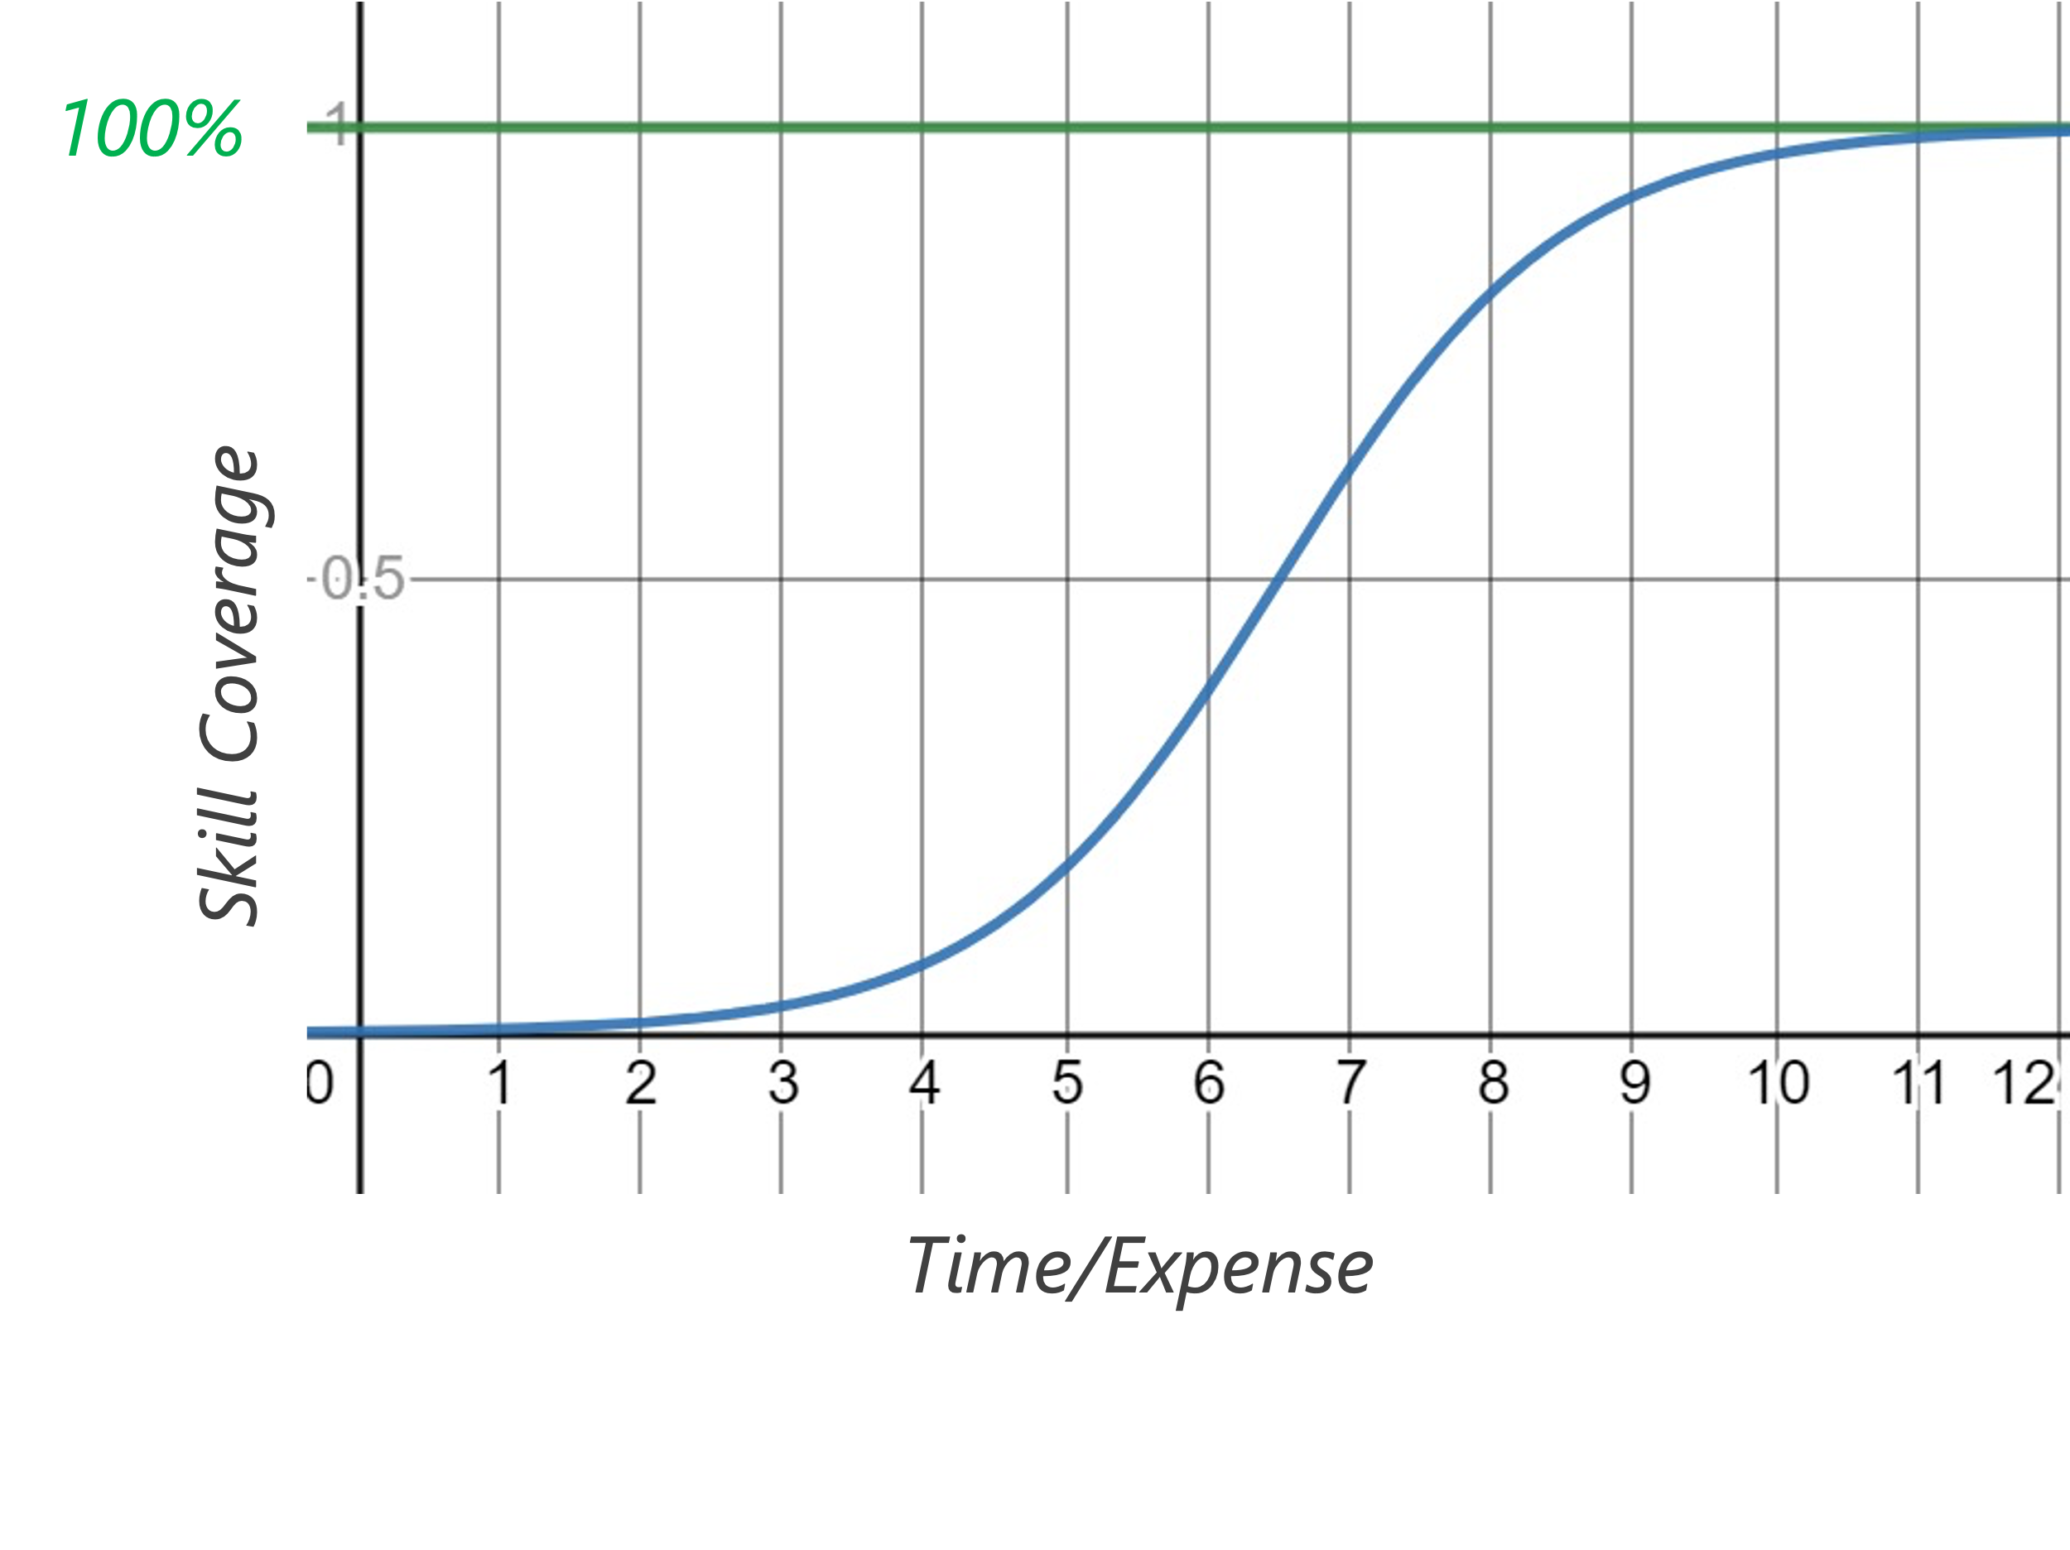
Covering the Whole Domain
Stefan Seltz-Axmacher (CEO of defunct Starsky Robotics) shared an interesting industry insight on AI capability.
Take an “AI” system like virtual assistants (e.g. Alexa, Siri) or fully autonomous vehicles; many popularly believe that AI capability is exponential much akin to Moore’s Law, but it is in fact a logistic S-curve.
Time and expense is invested to create an “AI” with more skills, hoping to nearly reach 100% coverage of desired capabilities.
The logistic curve to the right shows an ideal situation where enough time and expense shows a nearing of 100% skills coverage.
Is this realistic though? Any guesses on what the curve looks like in reality?
>
https://medium.com/starsky-robotics-blog/the-end-of-starsky-robotics-acb8a6a8a5f5
http://www.autonocast.com/blog/2020/3/27/181-stefan-seltz-axmacher-on-the-end-of-starsky-and-the-future-of-autonomy

Slide 25
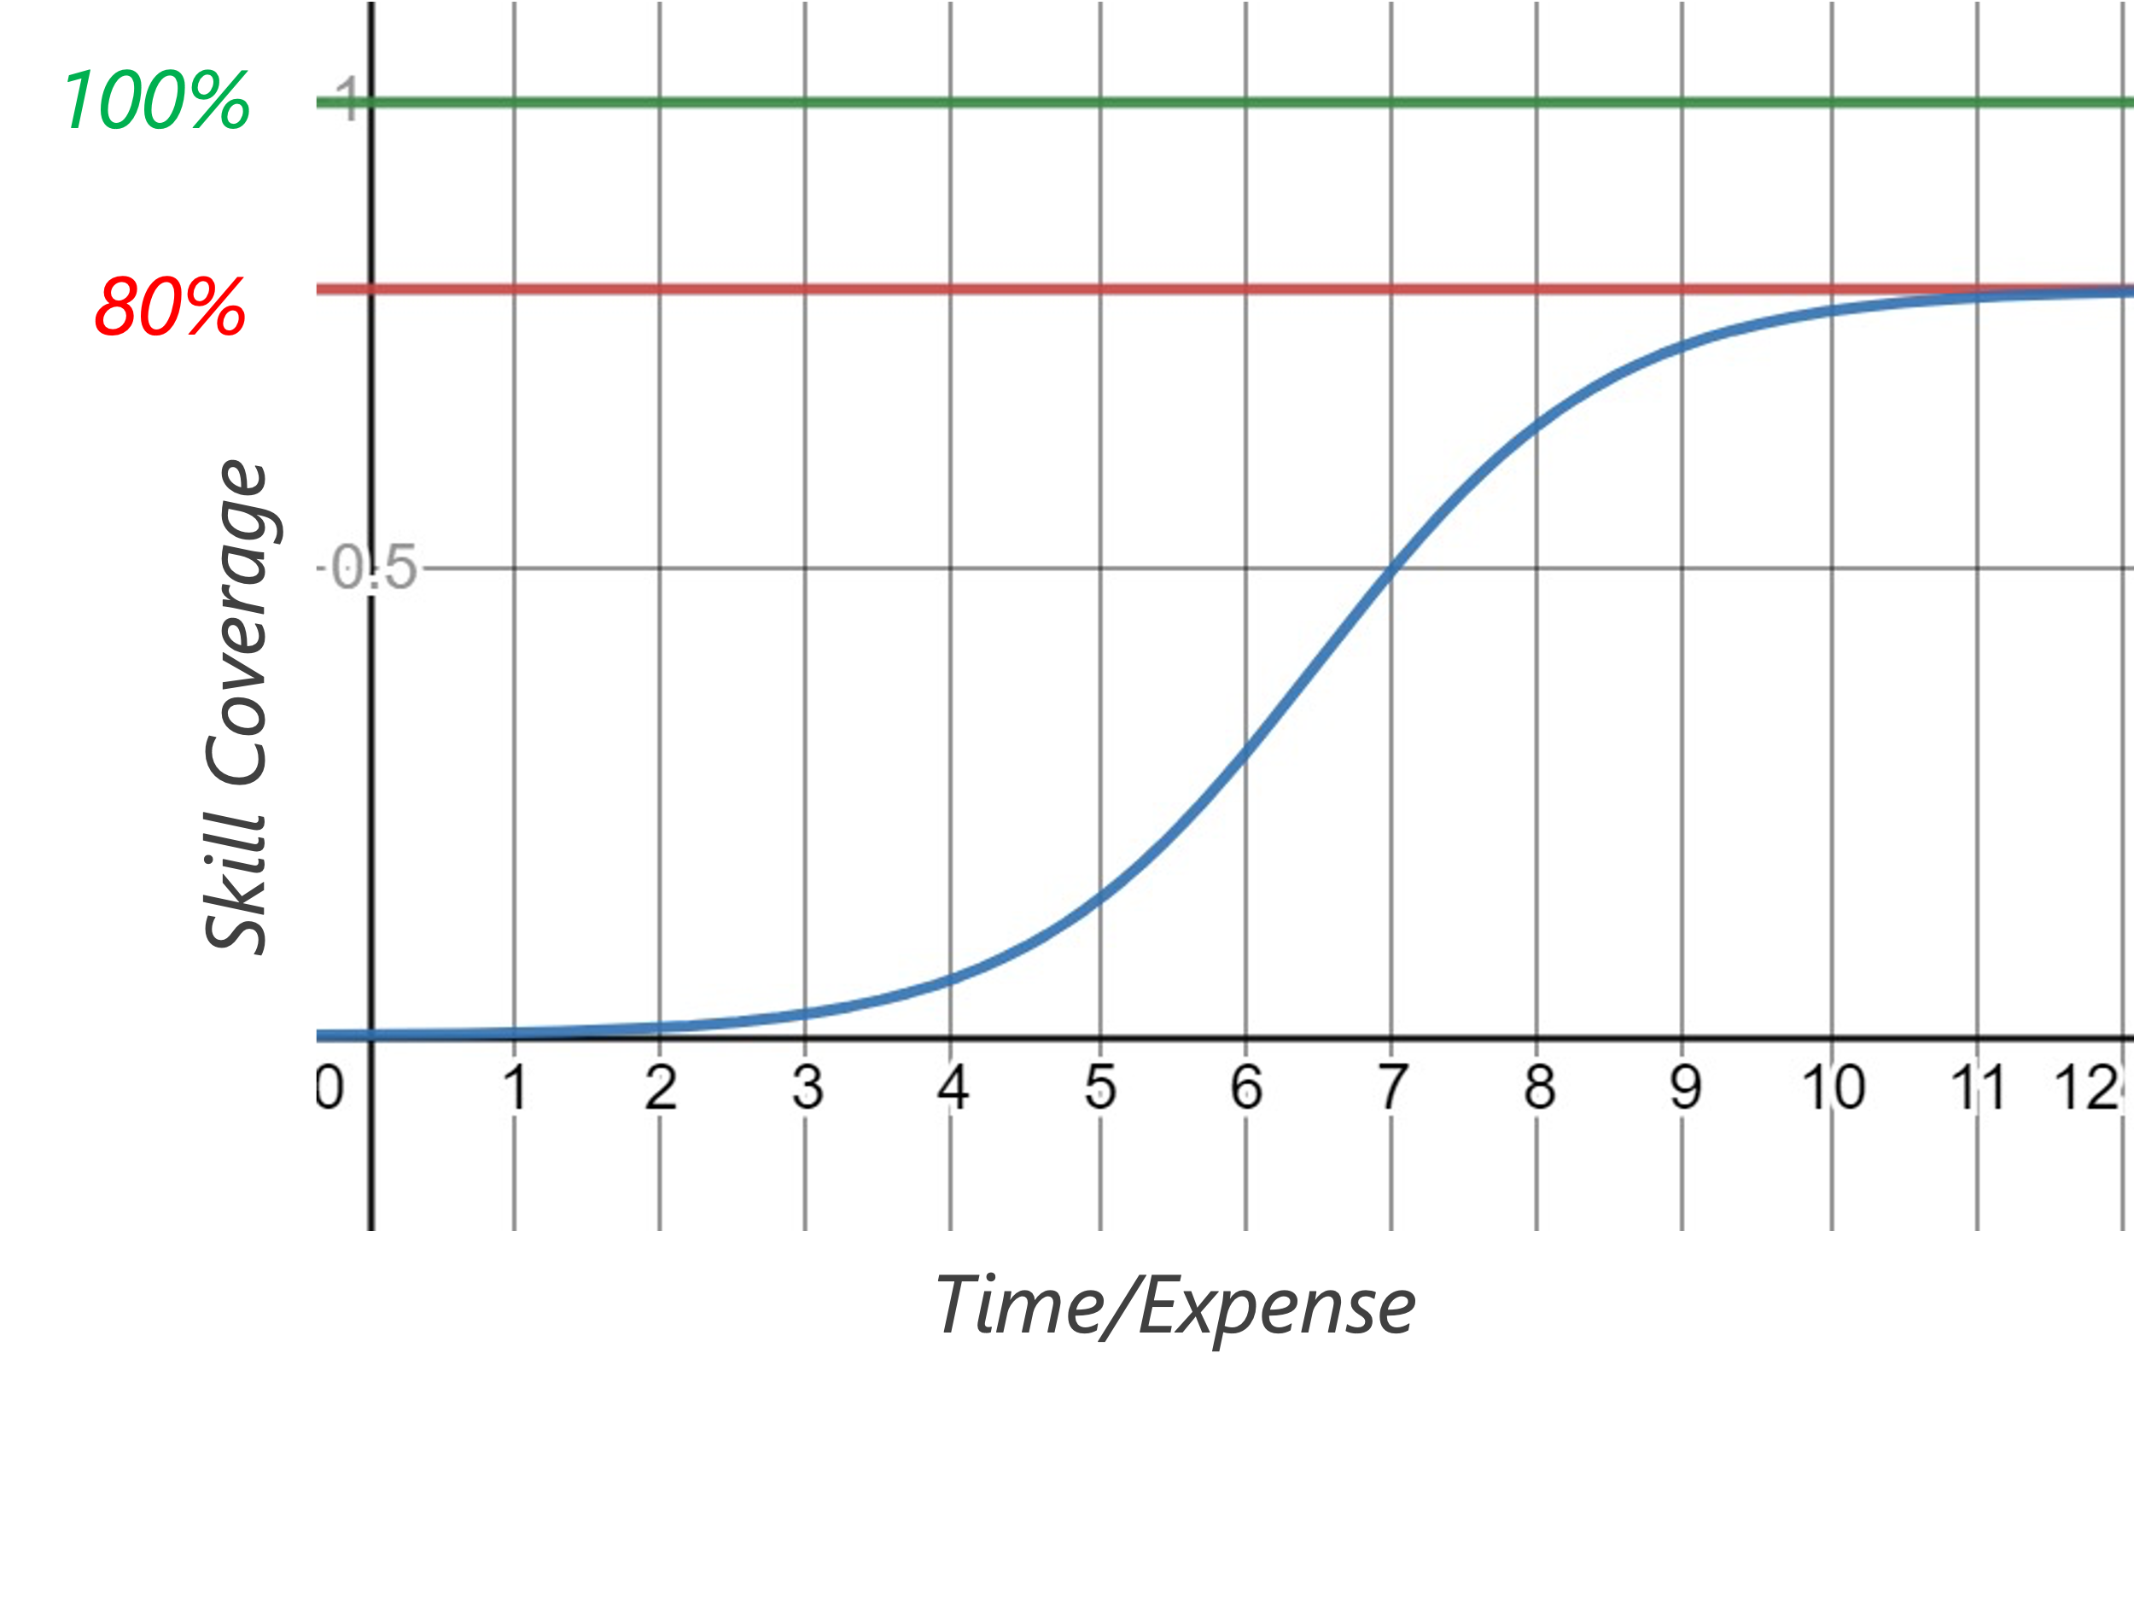
Covering the Whole Domain
To the right is a different outcome, where skill coverage converges on a much lower ceiling than 100%.
This is the largest problem with the “AI” industry.
Several tech companies building “AI systems” found that several skills can be added in stride with initial expense, but a diminishing return for “cost per new skill added” is ultimately encountered.
Due to computational and training data limits, and the high volume of outlier cases, it becomes practically impossible to create an “AI” that nears 100% coverage of needed skills without exponential expense.
This demonstrates that it is not AI capability that is exponential, but rather the expense to make it.
>
https://medium.com/starsky-robotics-blog/the-end-of-starsky-robotics-acb8a6a8a5f5
http://www.autonocast.com/blog/2020/3/27/181-stefan-seltz-axmacher-on-the-end-of-starsky-and-the-future-of-autonomy

Slide 26

Quoting Andrew Ng
“It turns out that when we collect data from Stanford Hospital, then we train and test on data from the same hospital, indeed, we can publish papers showing [the algorithms] are comparable to human radiologists in spotting certain conditions.
“It turns out [that when] you take that same model, that same AI system, to an older hospital down the street, with an older machine, and the technician uses a slightly different imaging protocol, that data drifts to cause the performance of AI system to degrade significantly. In contrast, any human radiologist can walk down the street to the older hospital and do just fine.
“So even though at a moment in time, on a specific data set, we can show this works, the clinical reality is that these models still need a lot of work to reach production.”
- Andrew Ng, Former Head of Google Brain and Deep Learning Education Pioneer
>
https://spectrum.ieee.org/view-from-the-valley/artificial-intelligence/machine-learning/andrew-ng-xrays-the-ai-hype

Slide 27
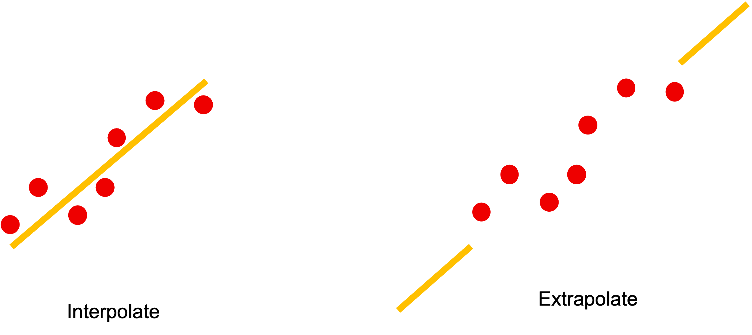
Interpolation vs Extrapolation
>

Slide 28
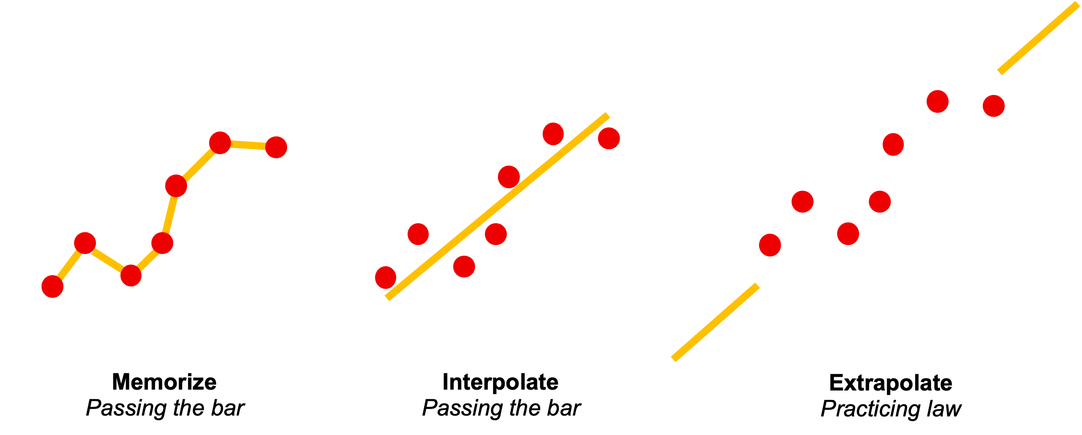
AI Passing the Bar ≠ AI Practicing Law
>

Slide 29
Section 3: Identifying Bias

Slide 30
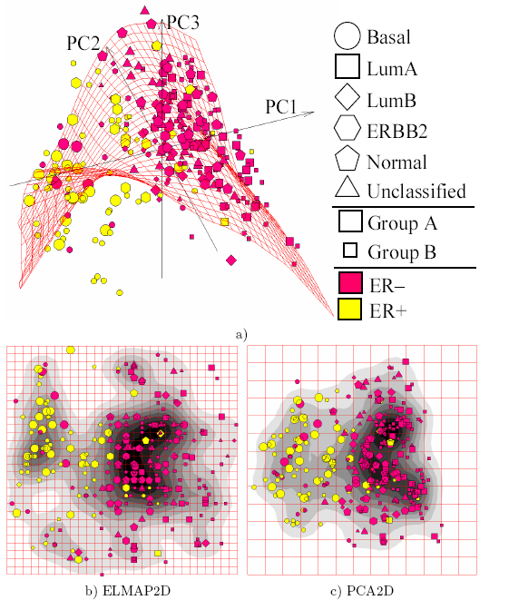
Missing the Forest for the Trees
A vendor has approached your military aircraft operation. They have an AI model that uses data collected from aircraft returning from combat and predicts where lightweight armor needs to be.
It uses detailed data, sometimes manifold dimension reduction, then applies K-means clustering algorithms identifying where bullet holes and damage are likely to be found. It then recommends armoring those hot spots.
What questions do you have for the vendor? Is their data pipeline and methods sound? Why or why not?
Principal component analysis (PCA) and other manifold methods are used to compress multiple dimensions into fewer dimensions, in this case flattening aircraft surfaces so bullet holes can be clustered.
>

Slide 31
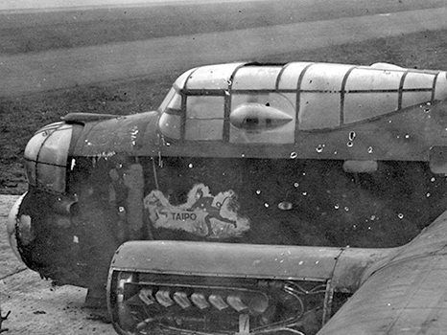
Missing the Forest for the Trees
This is a modernized version of a real data problem back in WWII.
https://apps.dtic.mil/docs/citations/ADA091073
The Center for Naval Analyses conducted a study on mitigating the loss of bombers. After analyzing fleets of bombers returned from missions, they conclude surfaces that statistically show the most damage should be prioritized for more armor.
But a Hungarian mathematician named Abraham Wald pointed out a fatal flaw with this heuristic.
SOURCE: Wikimedia Commons
>

Slide 32
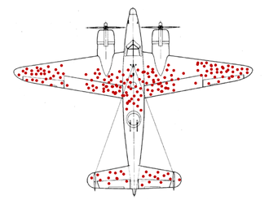
Missing the Forest for the Trees
The flaw: the data only captured survived aircraft, and therefore the heuristic was wrong.
This is an example of survival bias, a type of selection bias where we make faulty inferences on the survived population while the deceased population is never accounted for.
While many would cynically say the data is incomplete, the data still provides a valuable clue to solve our objective.
The question we should be asking: why did the aircraft return safely despite the observed damage?
With success, Abraham flipped the theory by armoring the undamaged parts of the aircraft, inferring these were likely the critical areas causing a plane to go down and never returning to base.
This not only saved aircraft and lives but was a pivotal moment for the war effort.
This Photo is licensed under CC BY
>

Slide 33
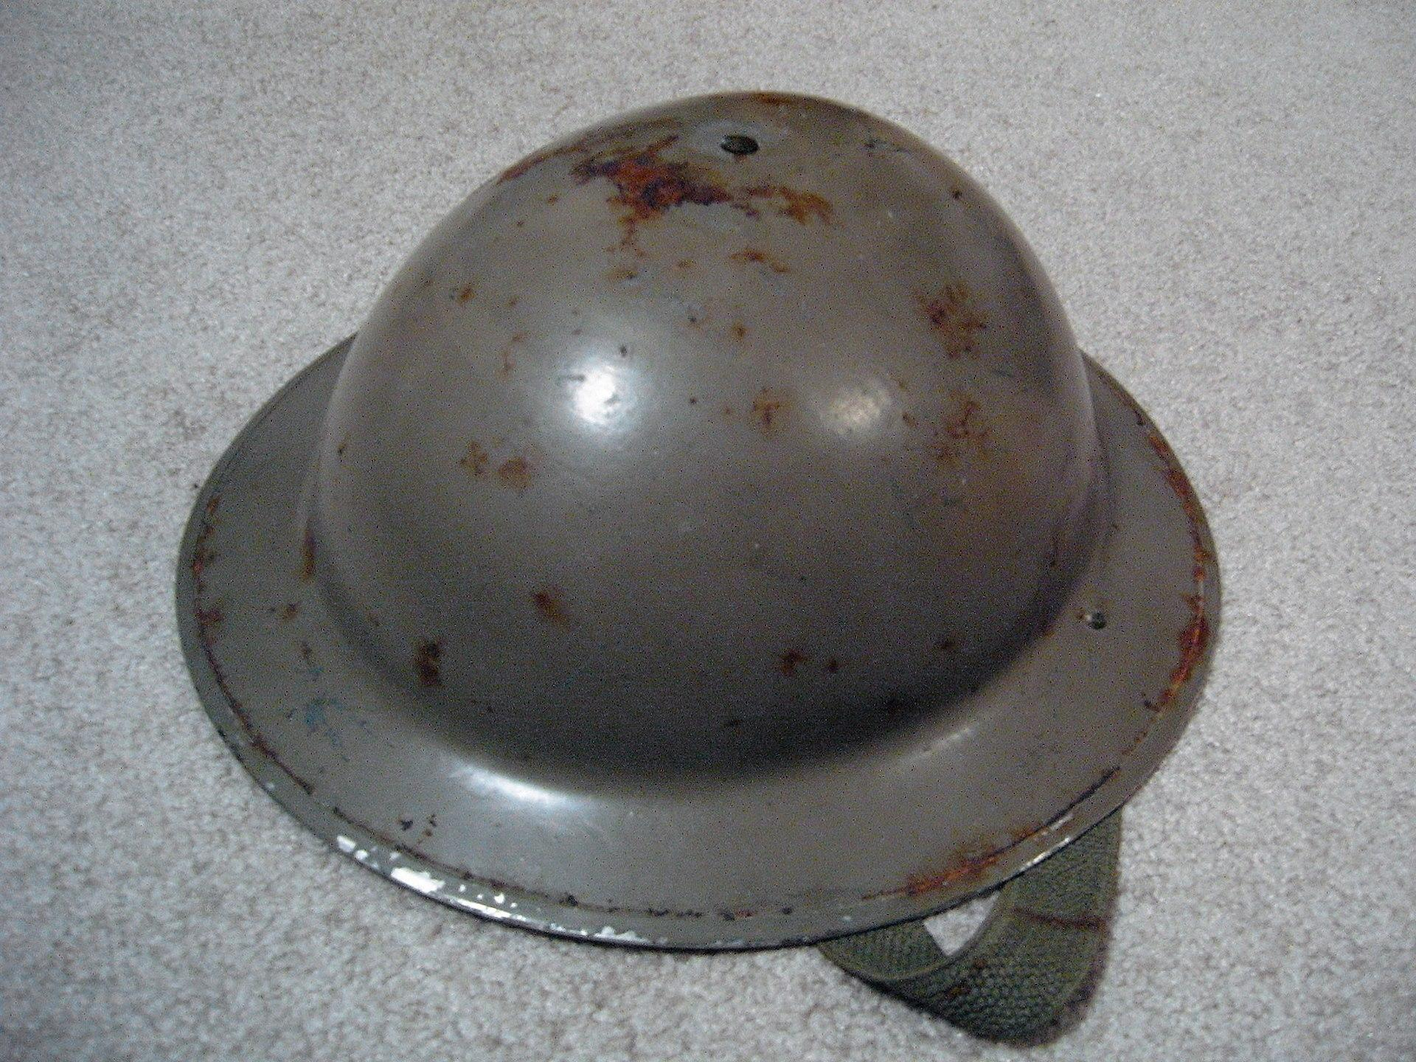
Lighting Round: Identifying Biased Data
In WWI, the British introduced the Brodie helmet. It was supposed to mitigate head injuries from shrapnel. When the number of shrapnel head injuries increased, British officers thought the helmet was failing.
Should the helmet be abandoned? Why or why not?
No! As discovered later on, the helmet was working, because more soldiers were being injured instead of killed.
>

Slide 34

Lighting Round: Identifying Biased Data
In 1984, a psychology professor at Virginia Tech presented a research paper at the American Psychological Association.
He observed three bars near the college campus and found that students who ordered beer by the pitcher consumed twice as much as those who ordered by the glass/bottle.
He concluded that “if we banned pitchers of beer, we would have a significant impact on [reducing] drinking.”
Is his theory plausible? Why or why not?
No! Subsequent studies showed that students who intend to get intoxicated will do so no matter what container they use. This is known as self-selection bias and the pitcher is a confounding variable.
Smith, G. (2016). Standard deviations. Gerald Duckworth & Co.
>

Slide 35
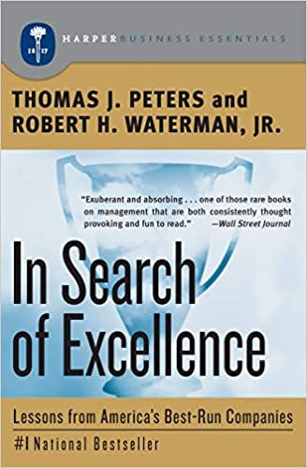
Lighting Round: Identifying Biased Data
In 1982, two McKinsey & Company consultants wrote the book In Search of Excellence covering what they believed to be traits of 43 successful companies: bias for action, closeness to the customer, autonomy and entrepreneurship… just to name a few.
While controversial at McKinsey, the book was successful and popularly considered a classic. Should the book be treated as a blueprint of success?
No! This is survival bias, not accounting for businesses that failed in obscurity who might have had the same traits but never made it to the limelight.
One could argue the book was filled with falsifiable truisms as well: who would openly be against bias for action, closeness to customer, etc.?
Any book that talks about successful traits of companies/individuals should be treated dubiously simply because of survivor bias.
>

Slide 36
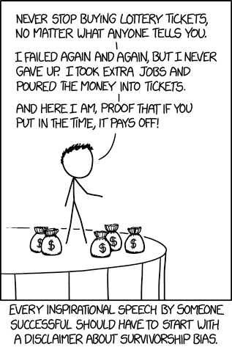
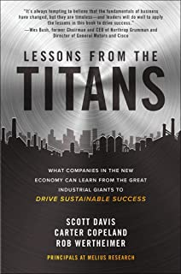

Survivorship Bias
Source: xkcd.com
>
Pg: 1

Slide 37

Lighting Round: Identifying Biased Data
An online forum has a thread posting success stories about a new fitness trend.
41 users have posted photos of their before/after results and the number of pounds they lost, all of which are 15-35 lbs.
Is this compelling evidence the program works? Why or why not?
Not necessarily. There could be survivor/self-selection bias. Users are far more likely to share results if they were successful, while users who attempted the diet and failed are unlikely to report their results.
A control and test group is needed to objectively evaluate the efficacy of the diet.
>

Slide 38

Lighting Round: Identifying Biased Data
In 1987, veterinary studies showed that cats who fell from 6 stories or less had greater injuries than those that fell more than 6 stories.
Prevailing scientific theories said that cats righted themselves at about 5 stories, giving them enough time to brace for impact and inflict less injury.
Is this plausible? Why or why not?
No! The newspaper The Straight Dope posed an important question: what happened to the dead cats? People are not likely to bring a dead cat to the vet and therefore it’s unreported how many cats died from higher falls.
>

Slide 39

“Be Analysis-Driven, Not Data-Driven”
- Yours Truly

Slide 40
Thank You

